Slide 1
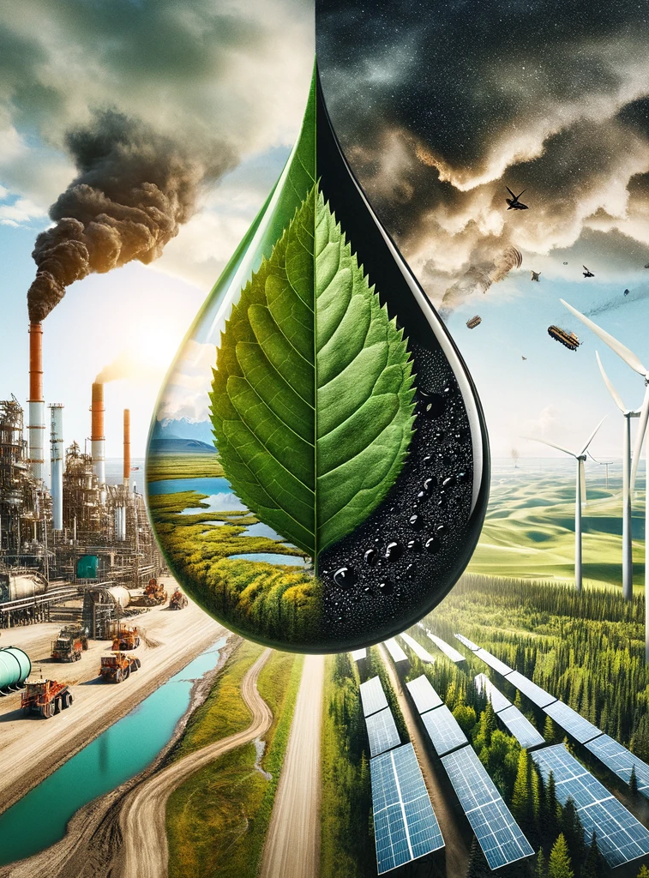
Unmasking the Petro-Narrative: Shifting Discourse on Alberta’s Oil Sands
Changing the Narrative on Alberta's Oil Sands
Talon Hird
June 2024
PHIL 359

Slide 2
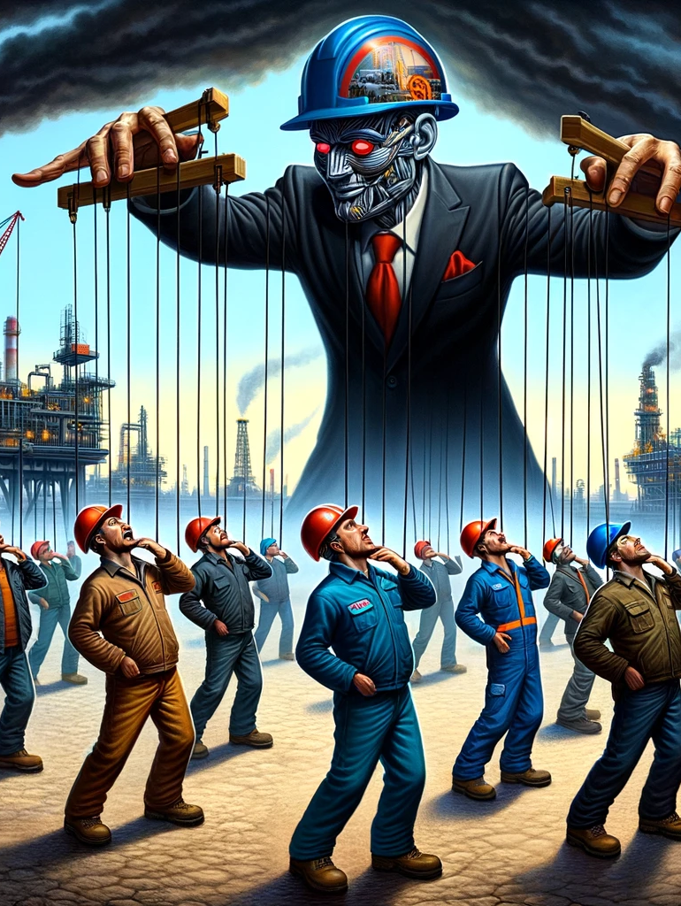
Introduction
The public perception of oil is shaped by narratives controlled by those benefiting from the capitalist distribution of oil, heavily influencing cultural attitudes in Alberta.
The extensive marketing and PR campaigns by big-oil make it hard to discern the true foundations of Albertan feelings toward oil. Likely largely due to propaganda
Discourse around curtailing oil usage often cites catastrophic environmental consequences, evoking feelings of loss and despair, which are less effective in persuasion.
The failure of anti-oil/environmental advocates to effectively influence discourse suggests the need for adopting similar rhetorical techniques as the pro-oil lobby to alter public consciousness about the oil-sands controversy.

Slide 3

Historical Influence of Oil Narratives
Controlled by Capitalist Interests:
Narratives have been shaped to benefit those who profit from oil.
Propaganda has been used to create a positive image of oil in the public mind.
Examples of Propaganda:
Campaigns and rhetoric used to promote oil as essential to Economy
Ex. Molding of American Economy around energy consumption

Slide 4

Oil as a Cultural Symbol in Alberta
Significance in Albertan Identity:
Oil is deeply ingrained in the cultural identity of Alberta.
Examples: Edmonton Oilers, Alberta as the “Energy Province.”
Campaigns like “Alberta is Energy”
Efforts to link oil with provincial pride and identity.
Use of slogans to reinforce the importance of oil in Albertan culture.
Made to seem indespensible to Albertan Economy
Low roaylties and subsidized (ACITTS)

Slide 5

Superior Rhetorical Techniques of Pro-Oil Lobby
Effective Strategies:
Pro-oil campaigns use emotionally resonant and psychologically compelling rhetoric.
They create narratives that make oil seem indispensable and beneficial.
Comparison with Anti-Oil Approaches:
Environmental advocates often focus on facts and statistics as well as warnings of future catastrophe.
These approaches are likely not as effective in changing public opinion.

Slide 6
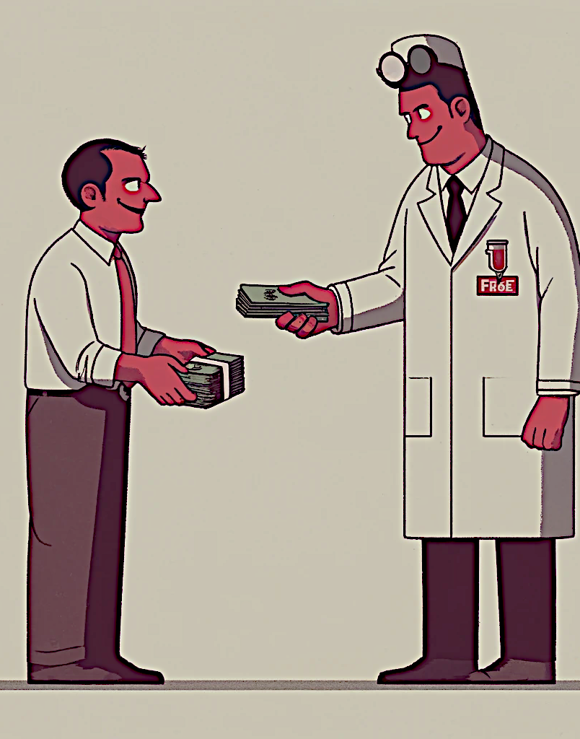
Misrepresentation of Scientific Evidence
Tactics by Pro-Oil Propagandists: (Merchants of Doubt)
Bankrolling scientists to create doubt about climate change.
Magnifying dissenting voices to confuse the public.
Impact on Public Understanding:
Misrepresentation makes it difficult for people to commit to concrete actions.
Creates confusion and apathy towards environmental issues.

Slide 7
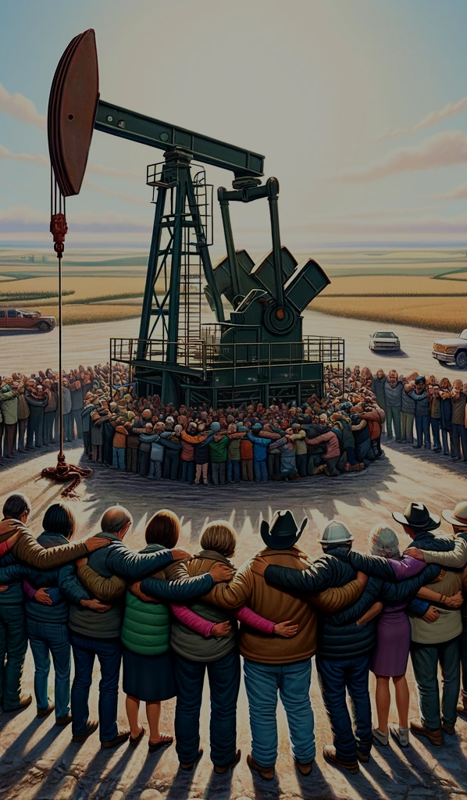
Psychological Manipulation and Lacanian Theory
Richard Kover’s Analysis:
Lacanian psychoanalytic theory explains the deep psychological impact of pro-oil narratives.
Oil is presented as the “object petit a,” an object of desire and identity.
Can create sense of belonging
Impact on Identity and Community:
Oil becomes more than a commodity; it’s integral to personal and collective identity.
This deep psychological connection makes it harder to shift public opinion.

Slide 8
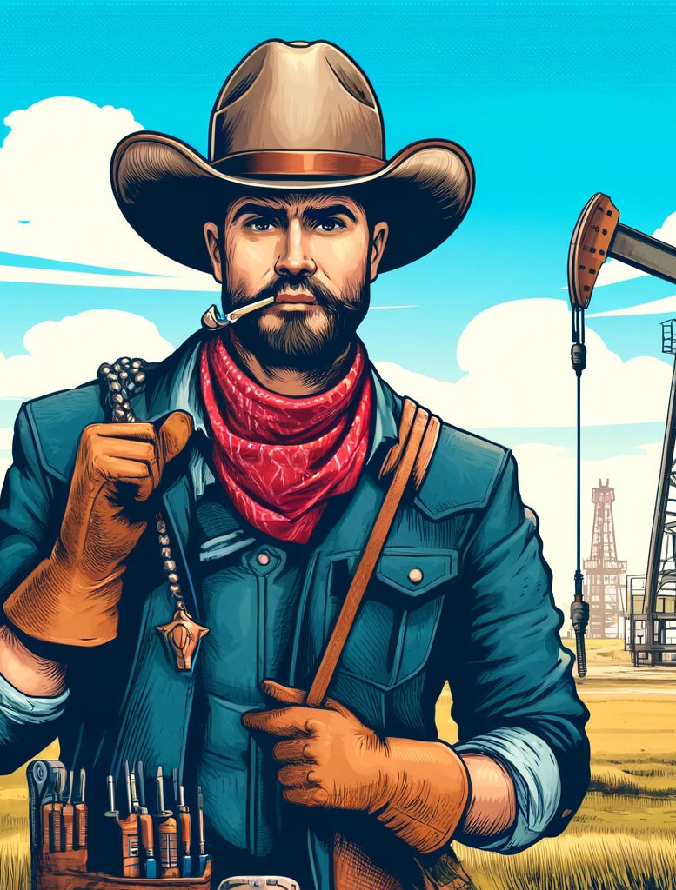
Frontier Masculinity
Motifs of rugged individualism and toughness are good examples of these psychological associations
Men can be emasculated or shamed for any behaviours that could be considered emasculate compared to cowboy motif like supporting feminism or asking for help (expressing support for green solutions can be extrapolated to be in this category)

Slide 9
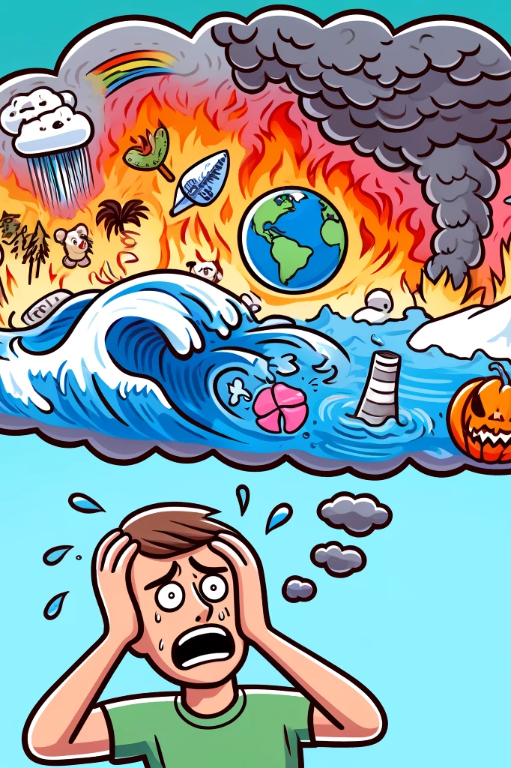
Climate Denial and Psychological Barriers
Kari Marie Norgaard’s Findings:
Climate inaction is not due to ignorance but a “socially organized denial.”
People compartmentalize climate knowledge to avoid negative emotions such as cognitive dissonance in daily life.
Espen Stoknes:
“Collapse porn” and disaster fatigue desensitize people to climate warnings.
Psychological barriers allow people to ignore the immediacy of climate issues.

Slide 10

Shifting the Narrative: Positive Framing
Importance of Optimistic Discourse:
Negative framing leads to fear and apathy.
Positive framing inspires hope and action.
Examples of Campaign Slogans:
“Pioneering a Sustainable Tomorrow” & “Innovation Drives Us Forward”
Evoke Positive Emotions
Focus on resilience, progress, and provincial pride.
Highlight benefits of a green future rather than sacrifices.

Slide 11
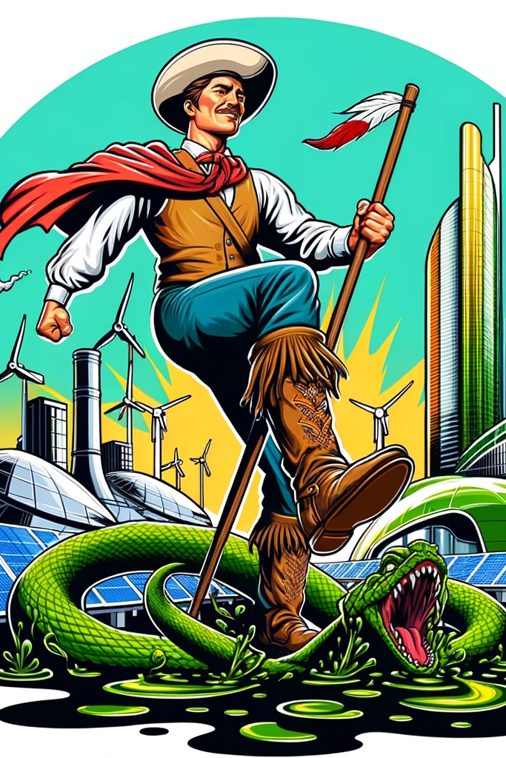
Strategies for a New Discourse
Create emotionally resonant narratives with skillful rhetoric
Use Lacanian signifiers to connect with core values of Albertans
Inspire Collective Shift:
Frame sustainability as an extension of Alberta’s pioneering spirit.
Make green energy a source of provincial pride and identity.
Highlight what Albertans have to gain

Slide 12
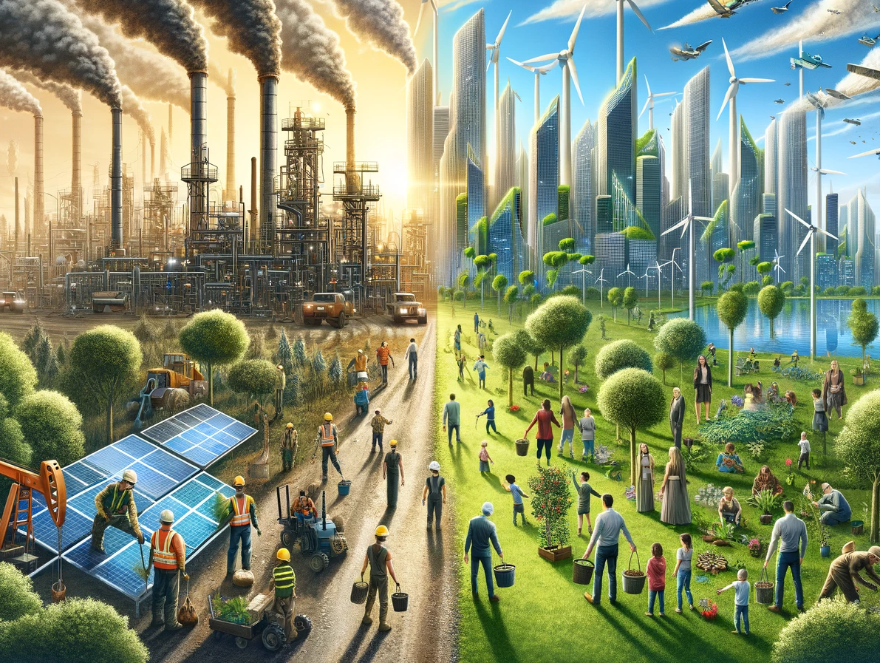
Conclusion
Pro-oil narratives have shaped Alberta’s identity through strategic manipulation.
Environmental advocates must adopt similar rhetorical techniques to shift public opinion.
Call to Action:
Fill Albertans with hope and optimism about a sustainable future.
Inspire action through compelling and emotionally resonant discourse.
Vision for the Future:
Unshackle Alberta from its oil-dependent identity.
Pave the way for a brighter and greener future.

Slide 13
Bibliography
Mitchell, Timothy. Carbon Democracy. London: Verso, 2011.
Haluza-DeLay, Randolph. 'Assembling Consent in Alberta: Hegemony and the Tar Sands.' In A Line in the Tar Sands: Struggles for Environmental Justice, edited by Toban Black, Tony Weis, Stephen D'Arcy, and Joshua Kahn Russell. Oakland, CA: PM Press, 2014.
Oreskes, Naomi, and Erik M. Conway. Merchants of Doubt: How a Handful of Scientists Obscured the Truth on Issues from Tobacco Smoke to Global Warming. New York: Bloomsbury Press, 2010.
Kover, T.R. 'Everything You Wanted To Ask Jacques Lacan About The Oil Sands But Were Too Afraid To Ask.' In The Lacanian Review. Publisher and year not specified.
Norgaard, Kari Marie. 'Climate Denial: Emotion, Psychology, Culture, and Political Economy.' In The Oxford Handbook of Climate Change and Society, edited by John S. Dryzek, Richard B. Norgaard, and David Schlosberg, 396-413. Oxford: Oxford University Press, 2011.
Stoknes, Espen. 'How to Transform Apocalypse Fatigue Into Action on Global Warming.' TED Talk. Accessed June 8, 2024. https://www.ted.com/talks/espen_stoknes_how_to_transform_apocalypse_fatigue_into_action_on_global_warming.
Miller, Gloria E. "Frontier Masculinity in the Oil Industry: The Experience of Women Engineers." Gender, Work and Organization 11, no. 1 (2004): 47-73.
All Images Created in CHAT GPT-4o Image creator by Talon Hird

